Slide 1

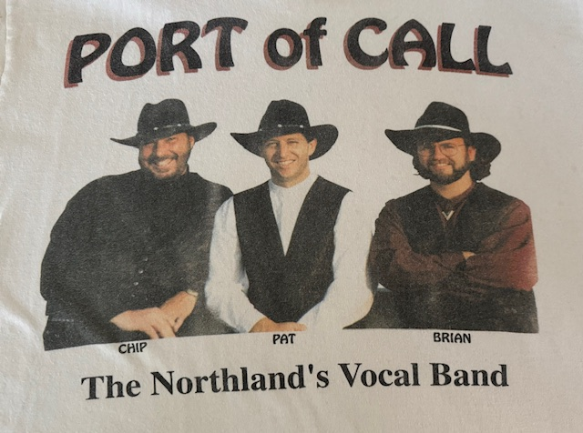



Saturday, JULY 25, 2026
Port of Call Reunion Concert
6:30 PM – 9:30 PM in the Eagle’s Nest
31 years in the
making
National Finalists in the
Jimmy Dean
True Value
Country Music Contest

